Slide 1
DCAITI-Project: Implementation of a Traffic Light Service on an (Android) Smartphone
Oday Kabha oday.kabha@ipk.fraunhofer.de
Yiyang Song yiyang.song@campus.tu-berlin.de
Yuanheng Mu johanmu1994@mailbox.tu-berlin.de
Supervisor: Birgit Kwella
Notes:
1

Slide 2
Overview
Review of First Presentation
Current Implementations
Milestone
2
06.01.2021
DCAITI -Projekt

Slide 3
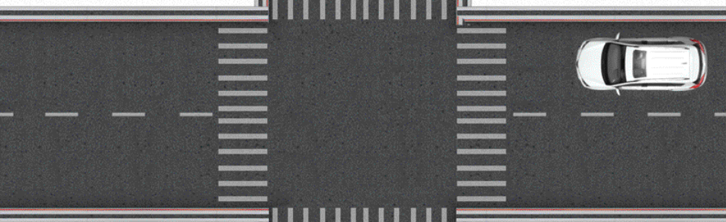
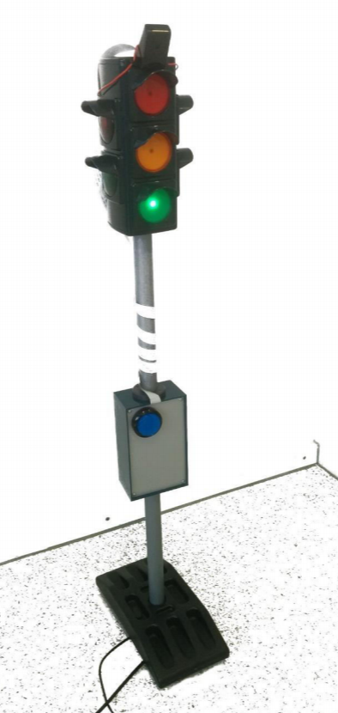
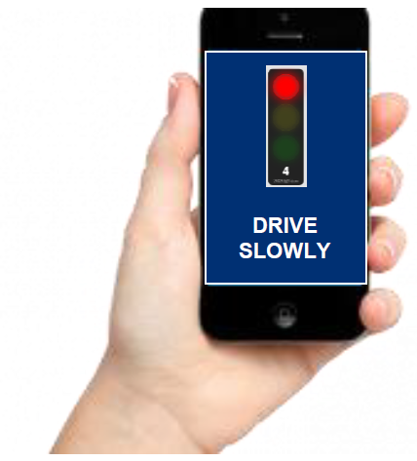
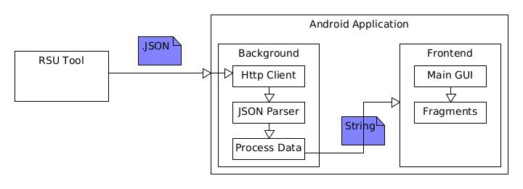
1.1 Review of First Presentation: Background & System Architecture
Background
System Architecture
RSU
SPaT & MAP
via automotive WiFi
3
06.01.2021
DCAITI -Projekt

Slide 4
1.2 Review of First Presentation: Tasks
Request, analysis and visualization of traffic lights information
Decision of driving strategy:
Simulation and evaluation
Determination of signal group
Generation of strategies
4
06.01.2021
DCAITI -Projekt

Slide 5
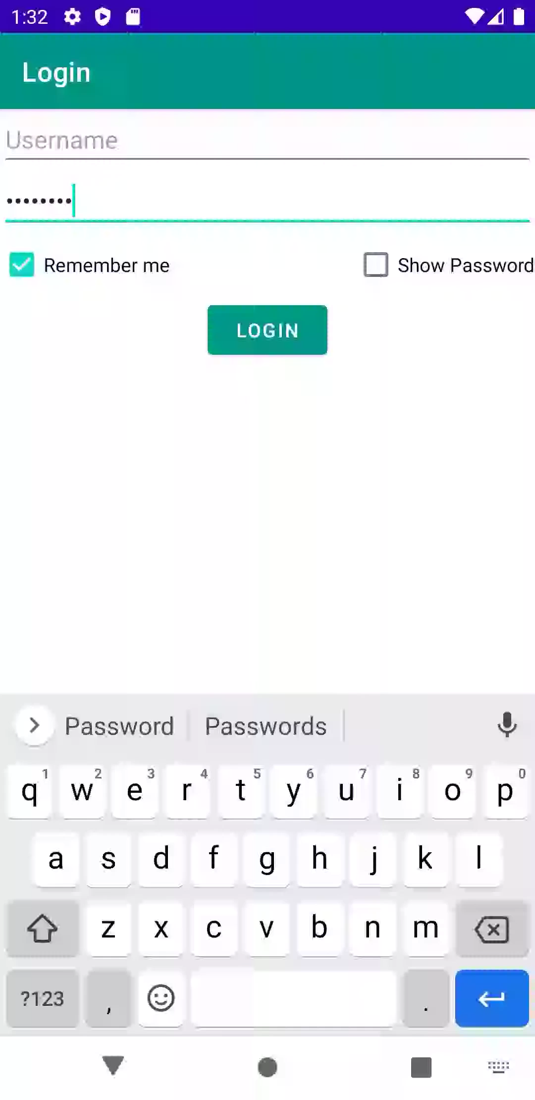
2.1 Current Implementations: Works about Client
Server to get SPaT & Map
Verifying Authorization
Function: to save key pair, hidden/show password
5
06.01.2021
DCAITI -Projekt

Slide 6





2.2 Current Implementations: Works about Traffic Light Monitor
JSON parser
According to SPaT Doc
Import parameter: IntersectionID, State, Likelytime
States:
6
06.01.2021
DCAITI -Projekt

Slide 7
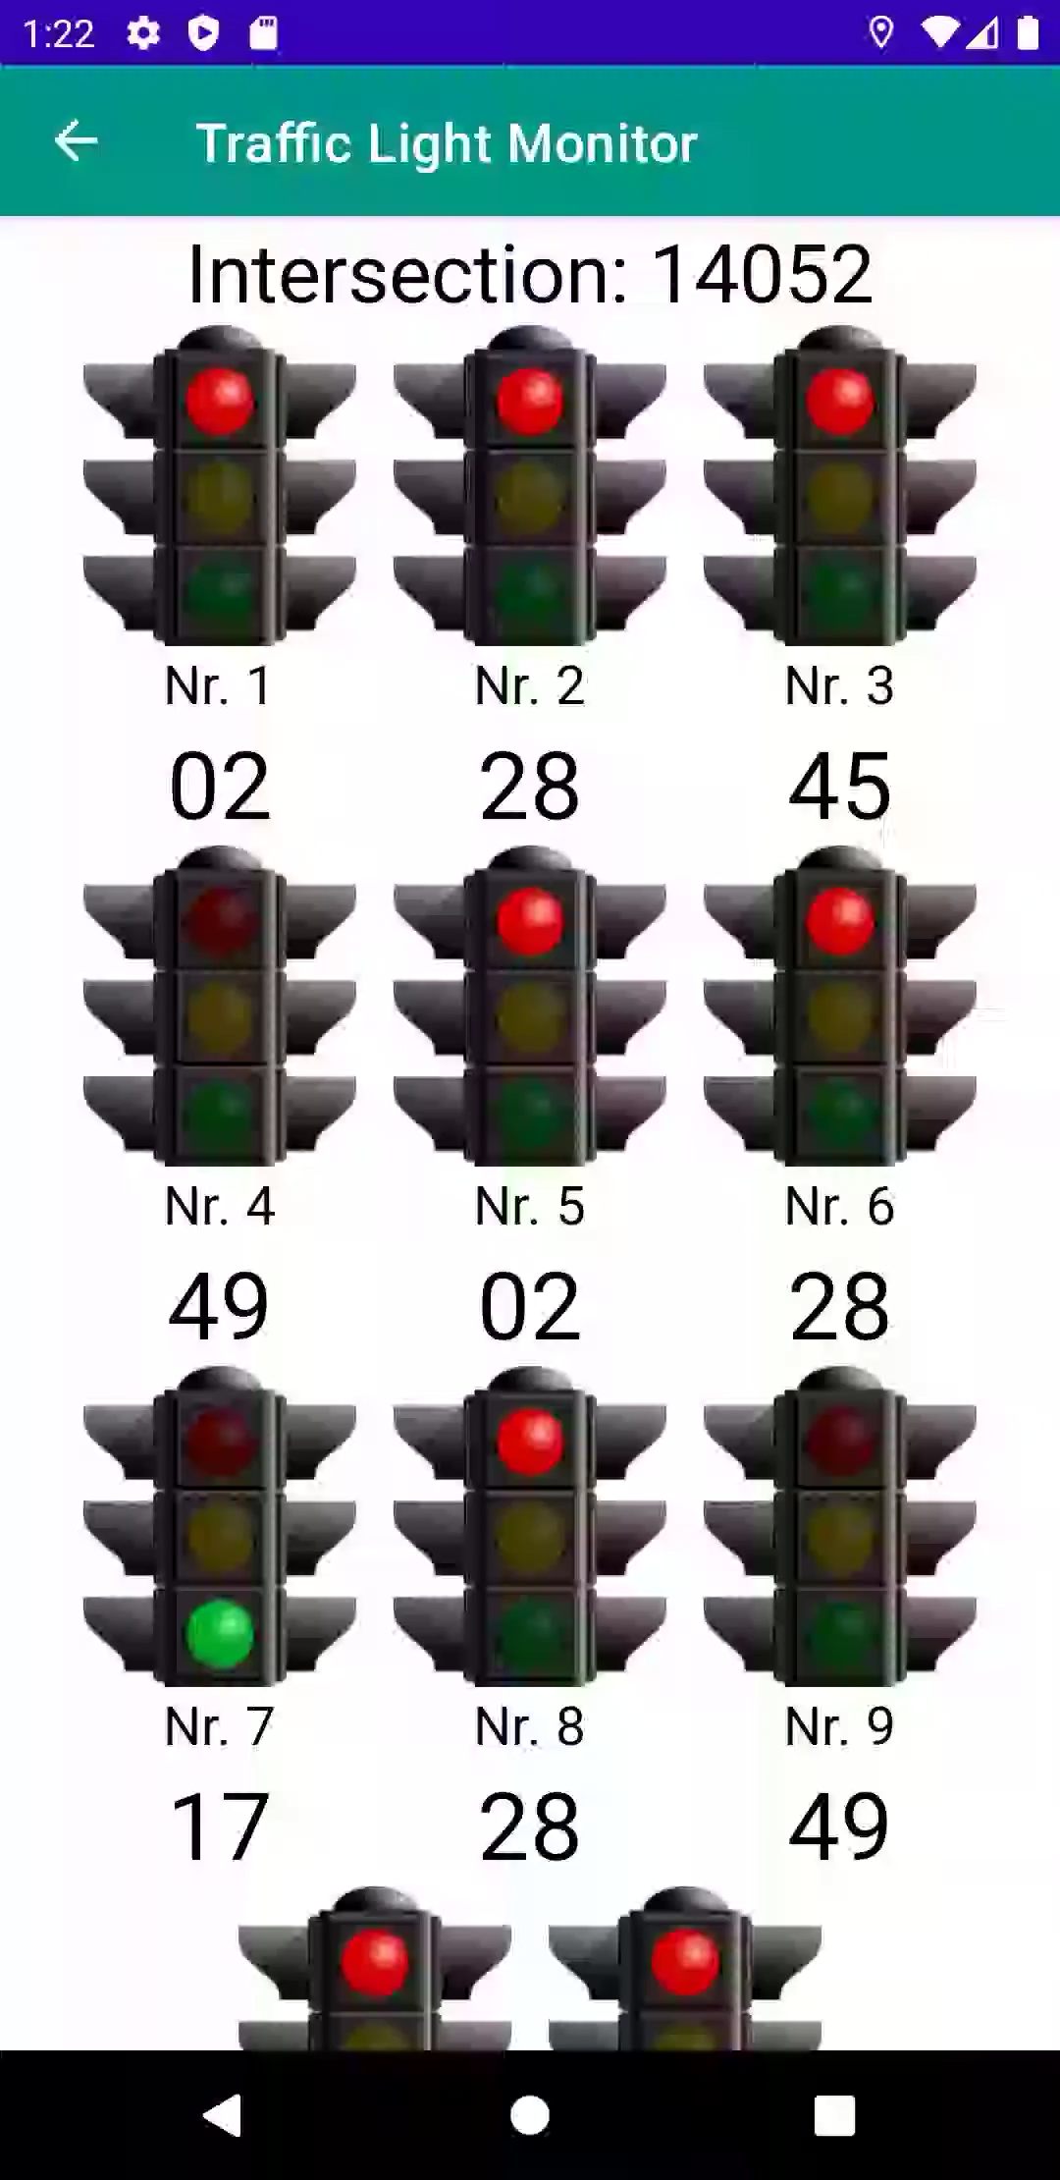
2.2 Current Implementations: Works about Traffic Light Monitor
JSON parser
According to SPaT Doc
IntersectionID
State
Likelytime
Function: monitor
7
06.01.2021
DCAITI -Projekt

Slide 8
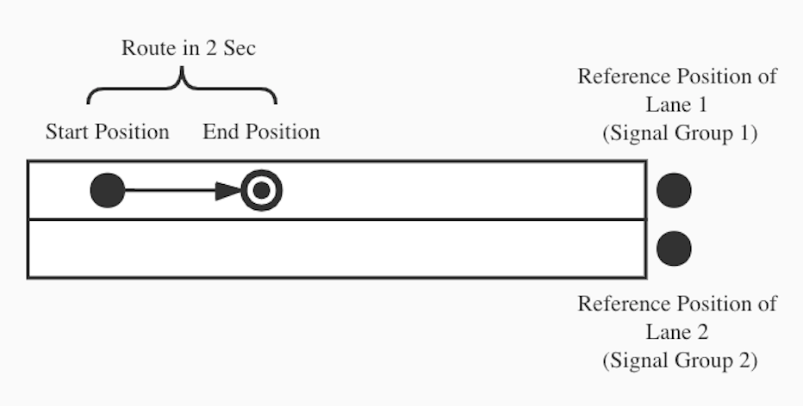
2.3 Current Implementations: Works about Determination
Algorithm 1
Linear Regression
Not suitable for real lane, which often in curve not straight line
Algorithm 2
Min Distance to Lane
Needs to add points in the curve of Lane to decrease deviation
8
06.01.2021
DCAITI -Projekt

Slide 9
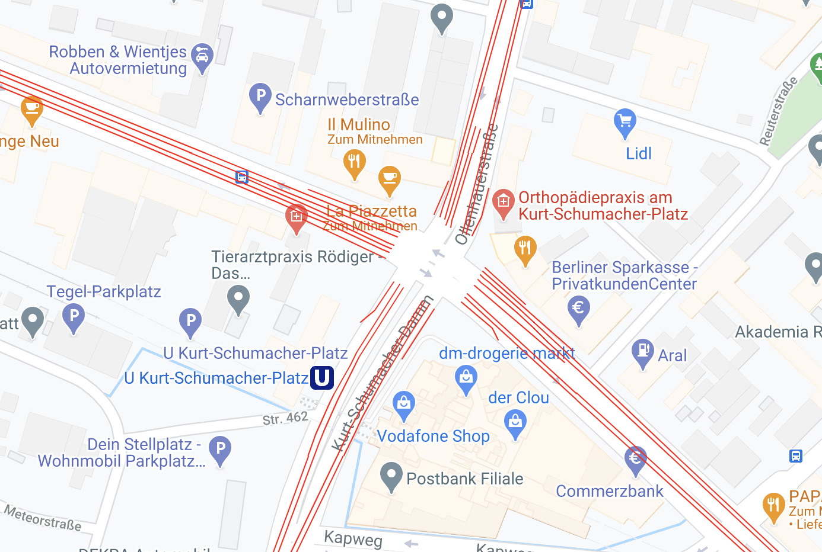
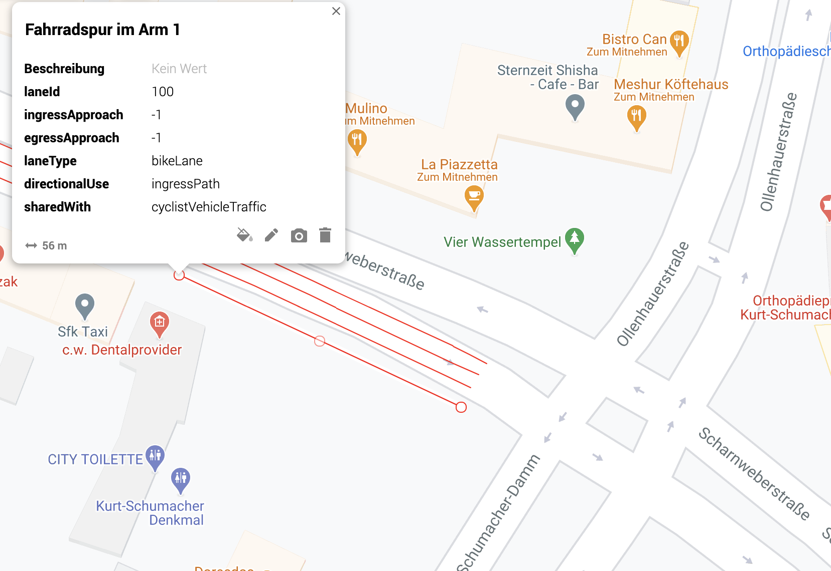
2.4 Current Implementations: Works about Map View
Routes Information in KML File
The Lane of Bicycle with ID 100 selected to test
9
06.01.2021
DCAITI -Projekt

Slide 10
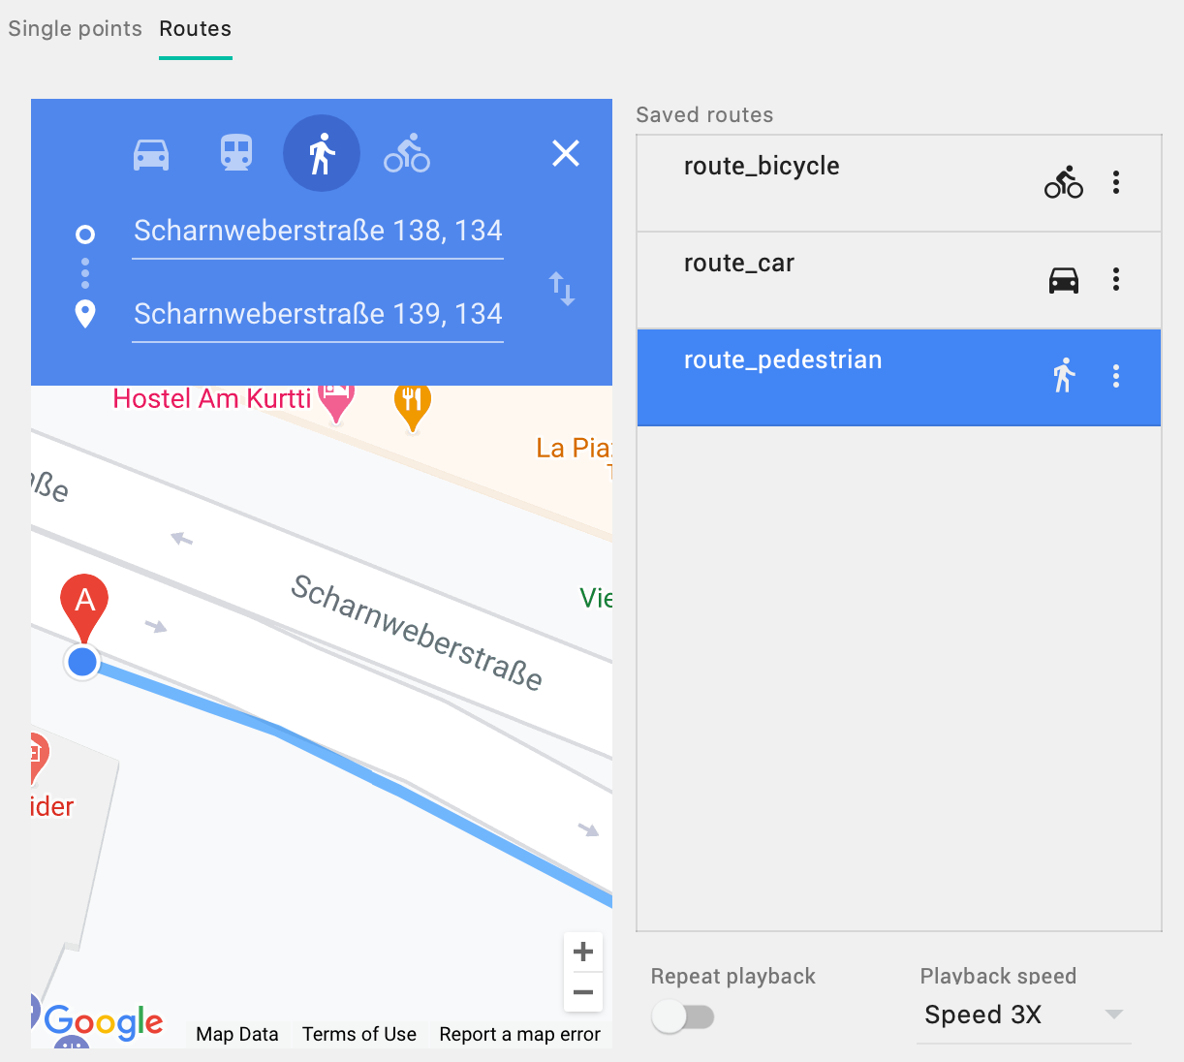
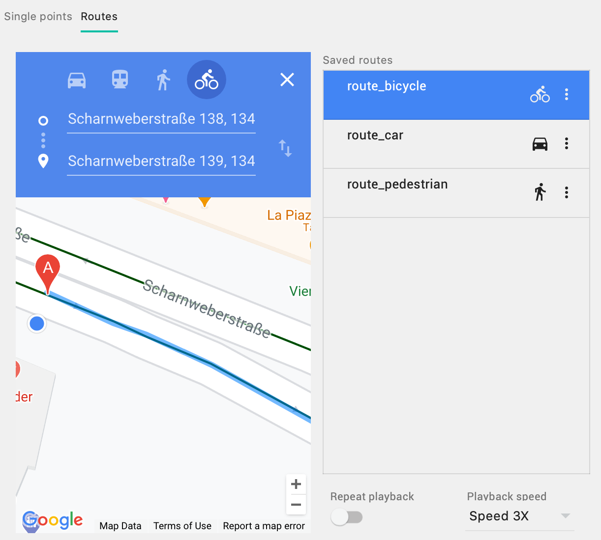
2.4 Current Implementations: Works about Map View
Simulating route in Android emulator
10
06.01.2021
DCAITI -Projekt

Slide 11
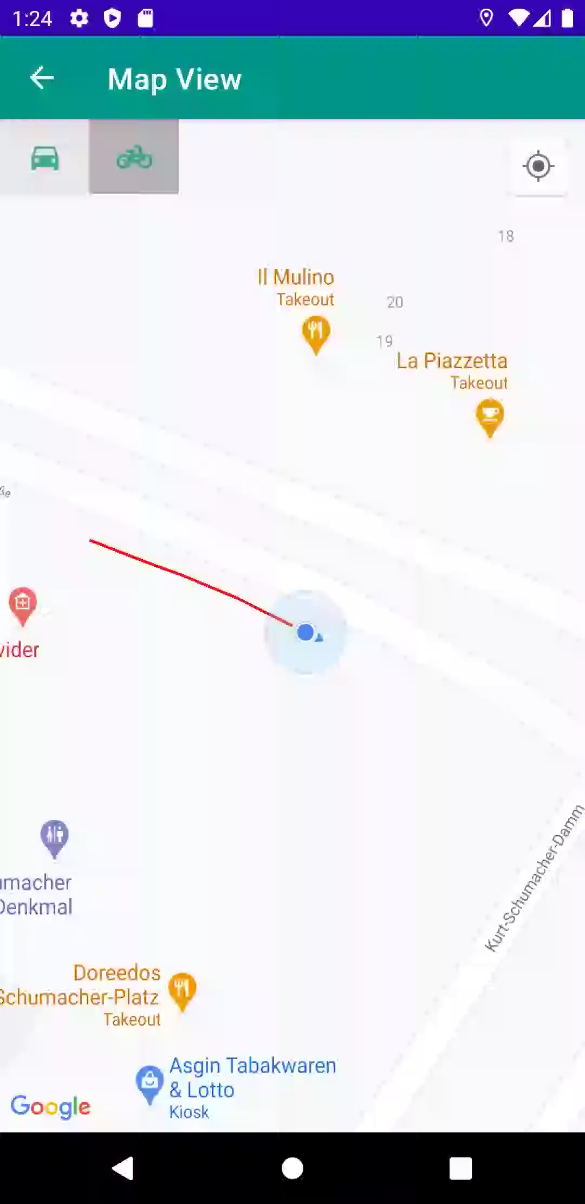
2.4 Current Implementations: Works about Map View
Google Map API v2 Key for Map View
com.google.android.gms.maps.SupportMapFragment
11
06.01.2021
DCAITI -Projekt

Slide 12
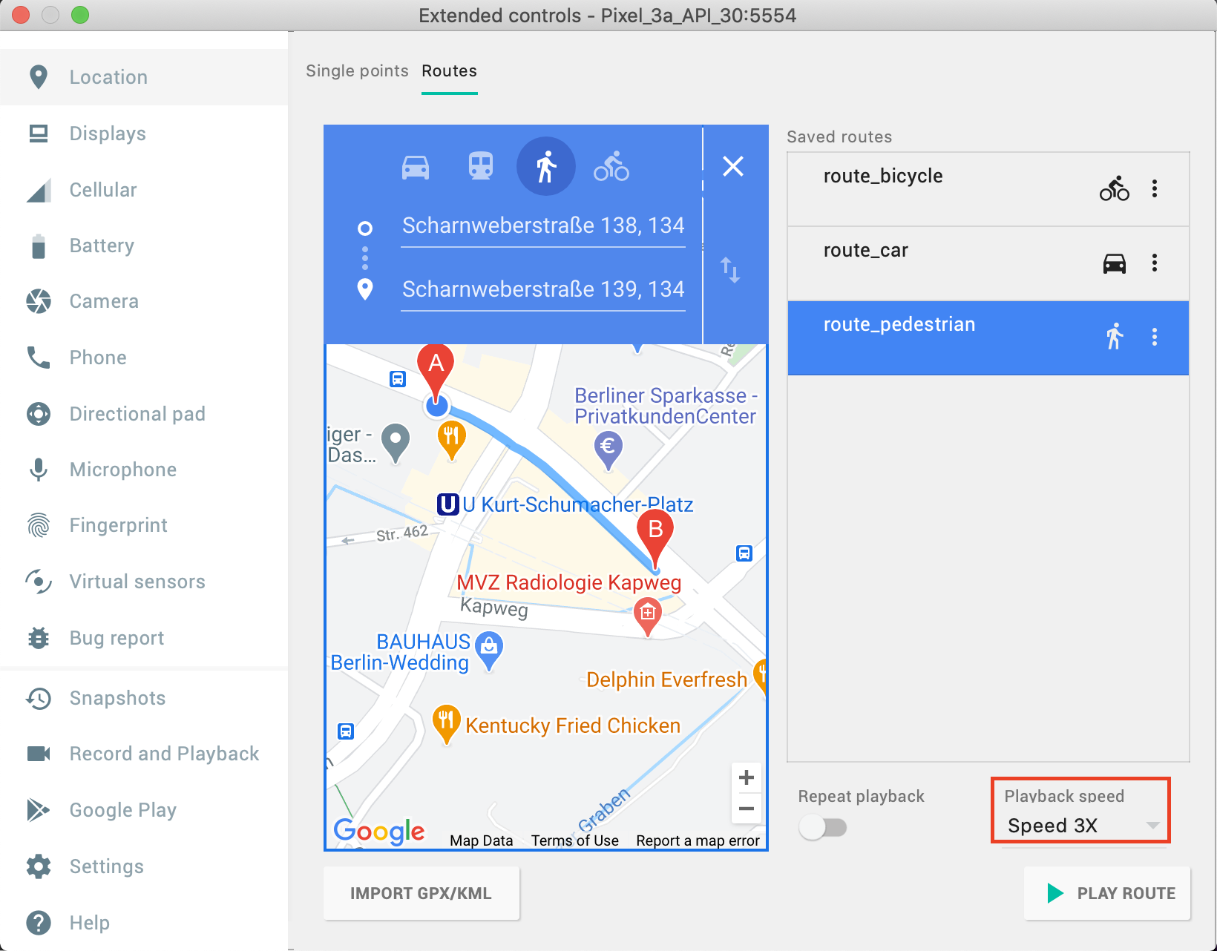
2.4 Current Implementations: Works about Map View
Simulating route in Android Emulator
Route of pedestrian with Speed 3X: around 13.5km/h
12
06.01.2021
DCAITI -Projekt

Slide 13
3. Milestone
13
06.01.2021
DCAITI -Projekt

Slide 14
Thanks for your attention!
Oday Kabha oday.kabha@ipk.fraunhofer.de
Yiyang Song yiyang.song@campus.tu-berlin.de
Yuanheng Mu johanmu1994@mailbox.tu-berlin.de
Notes:
14

